Slide 1
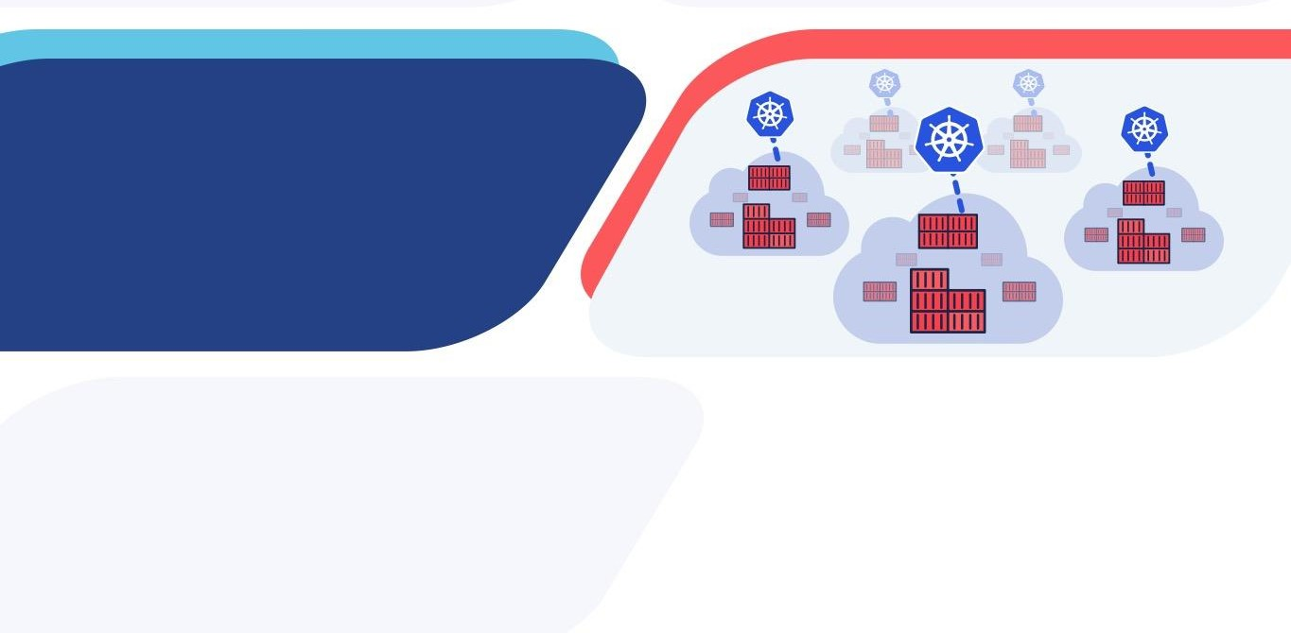
Securing Kubernetes Workloads
Best Practices for Securing Kubernetes Workload Configurations Across Clouds

Slide 2
Kubernetes Security Framework
 | Build | Operate
Container Hosts: | Minimal OS OS Hardening | CIS Benchmarks
Clusters: | RBAC Audit Policies and Logging Certificate Management | Identity and Access Kubernetes upgrades CIS Benchmarks
Applications: | Image scanning | Image Provenance Secrets Management Namespaces Access Controls Network Policies Resource Quotas Pod Security Policy

Slide 3
Kubernetes Security Framework
 | Build | Operate
Container Hosts: | Minimal OS OS Hardening | CIS Benchmarks
Clusters: | RBAC Audit Policies and Logging Certificate Management | Identity and Access Kubernetes upgrades CIS Benchmarks
Applications: | Image scanning | Image Provenance Secrets Management Namespaces Access Controls Network Policies Resource Quotas Pod Security Policy

Slide 4
Image Provenance
Image scanning checks images for vulnerabilities
o Ideally done when the image is built and before it is accepted into the image registry
Image provenance
Confirms that an image being deployed is from a trusted source
Confirms that image has not been not tampered with

Slide 5
Image Provenance - Solutions
Kubernetes ImagePolicyWebhook
Configured as an admission controller
Sends an ImageReview request
Expects an ImageReview response of accept or deny

Slide 6
Image Provenance - Solutions
Portieris
Also an admission controller
Integrates with Notary (a content trust store) – part of the The Update Framework (TUF)
Provides way to specify image security policies at a namespace and cluster level
https://github.com/IBM/portieris https://theupdateframework.github.io/ https://github.com/theupdateframework/notary

Slide 7
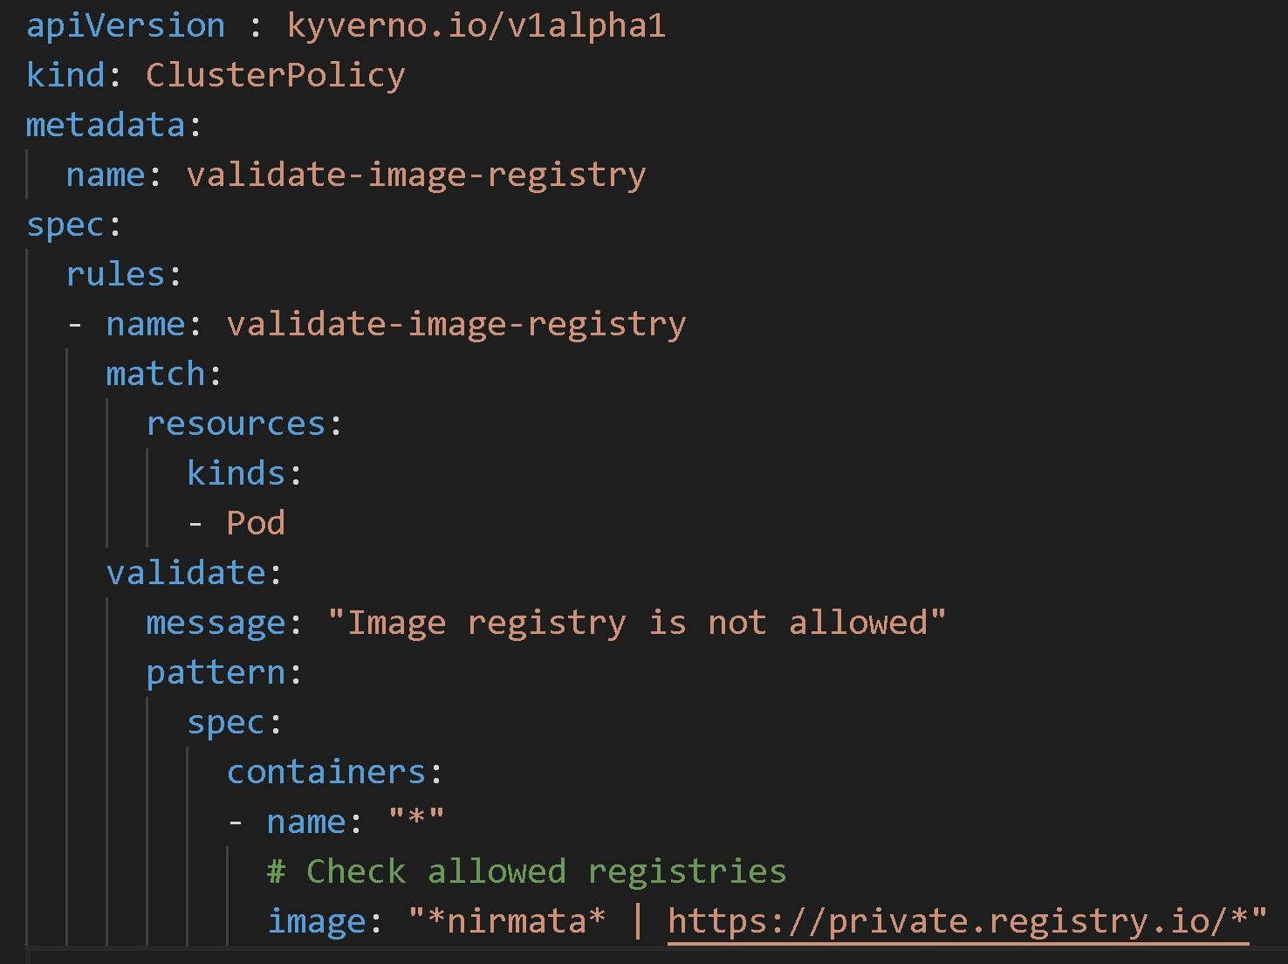

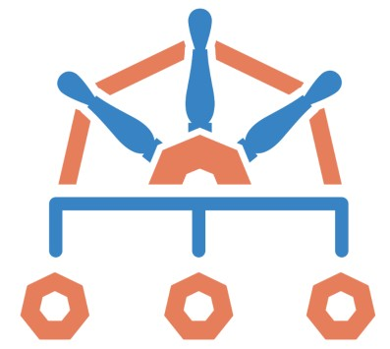
Image Provenance – Partial Solutions
Kyverno
Also an admission controller
Kubernetes Native Policy Engine
Policies are written as overlay rules
https://kyverno.io/
https://thenewstack.io/kyverno-kubernetes-configuration-via-policy/

Slide 8

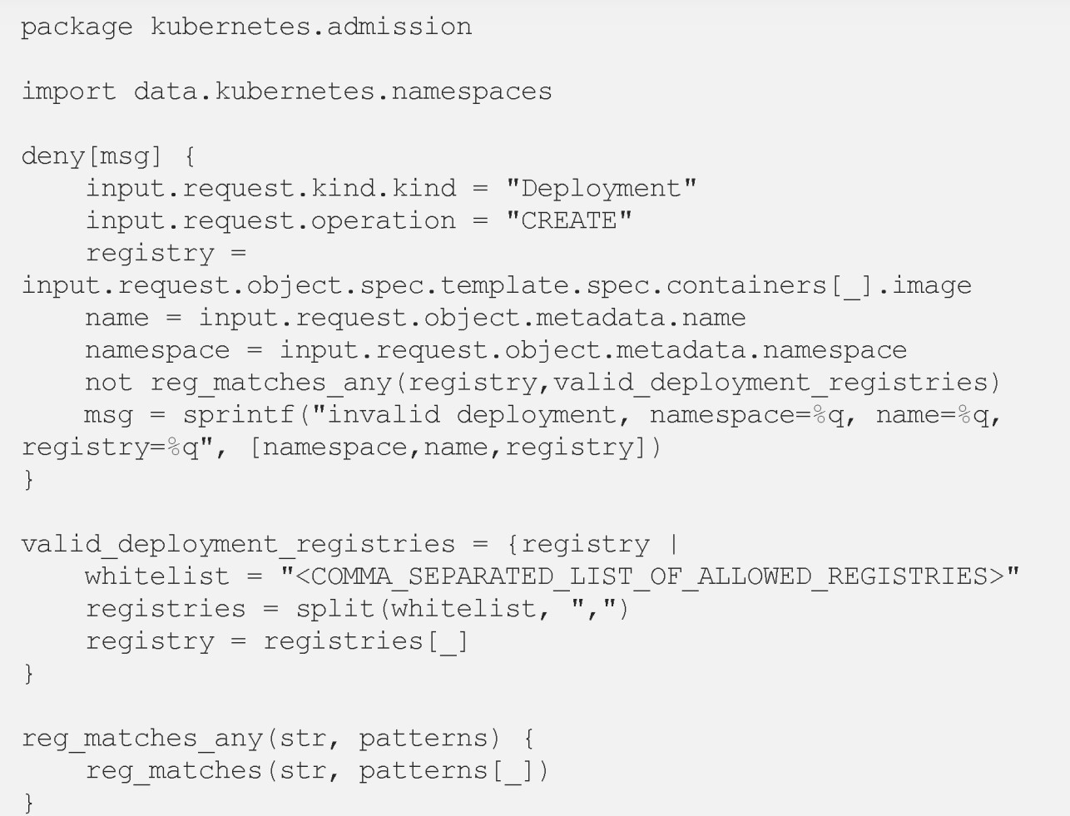
Image Provenance – Partial Solutions
OPA / Gatekeeper
Also an admission controller
General Purpose Policy Engine
Policies are written in Rego
https://www.openpolicyagent.org/ https://github.com/open-policy-agent/gatekeeper
https://medium.com/capital-one-tech/policy-enabled-kubernetes-with-open-policy-agent-3b612b3f0203

Slide 9
Secrets Management Anti-Patterns
(please try not to do this)
x Hard-coded
x Packaged with code
x Inserted via build tools x Environment Variables
Any sensitive data that an application needs
Passwords
Certificates
Keys
…

Slide 10
What Kubernetes Provides
API Object to define secrets
Values are base 64 encoded (default)
Secrets are namespaced
Secrets can be mounted as volumes
apiVersion: v1 kind: Secret metadata: name: mysecret type: Opaque data:
username: YWRtaW4=
Secrets can be used as environment variables
Encryption can be configured at the API Server

Slide 11
So, what’s missing?
Kubernetes secrets are a step forward, but have a few limitations:
Encryption requires configuring static keys or a KMS
Shared (static) approach
No leases, rotation, etc.

Slide 12

Secrets Management with Hashicorp Vault
Helps automates security best practices for
Secrets Management
Auditing
Certificate Management
Encryption
Dynamic Secrets
o Credentials (keys, passwords, certificates) are
generated when a client requests them
o Credentials are per client
o Credentials are automatically deleted if a lease expires

Slide 13
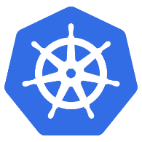



An init container to fetch secrets
Kubernetes Pod
Vault
…
Secrets
Service Account & Role
application
container
init container
Volume
(secret)
https://github.com/nirmata/kube-vault-client
https://www.nirmata.com/2018/12/19/managing-kubernetes-secrets-with-hashicorp-vault-and-nirmata/

Slide 14
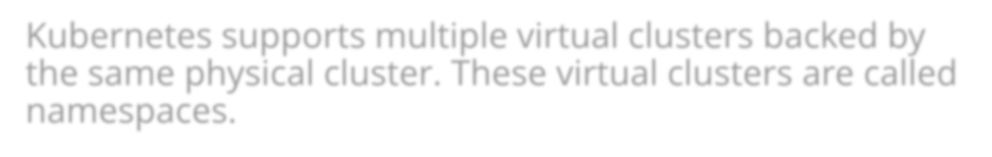

Namespaces
Kubernetes Data Plane Virtualization
Kubernetes supports multiple virtual clusters backed by the same physical cluster. These virtual clusters are called namespaces.
https://kubernetes.io/docs/concepts/overview/working-with-objects/namespaces/
Namespaces partition the Kubernetes object model so
multiple objects with the same name can exist in the same cluster
Namespaces are the foundation for applying other security constructs

Slide 15

Role-based access control (RBAC)
Users are authenticated via OIDC, X.509 certificates, tokens, etc.
The authentication result can provide user and group information.
However, Users and User Groups are managed externally (e.g. in an LDAP / AD server).
Kubernetes has a fine-grained permission model
Role (namespace) / ClusterRole
Roles are mapped to users or groups via role bindings
RoleBinding (namespace) / ClusterRoleBinding

Slide 16
Service Accounts
Service Accounts are meant for authenticating and authorizing processes
Each namespace has a default service account
Each Pod has a service account (default – if not specified)
A best practice is to use a service account per app
To prevent a service account token from being mounted in a Pod use “automountServiceAccountToken: false”. This can be enforced via a policy.

Slide 17
Network Segmentation via Network Policies
By default, Kubernetes pods are
“non-isolated”
They accept network connections from any source and can initiate connection requests to any destination
Network Policies define traffic rules for Kubernetes pods
ingress (inbound traffic)
egress (outbound traffic)
Network Policy
Pod Selector
Ingress
Ingress Rule
Ingress Rule
Ingress Rule
Egress
 |  | Egress Rule
Ingress Rule
Ingress Rule

Slide 18

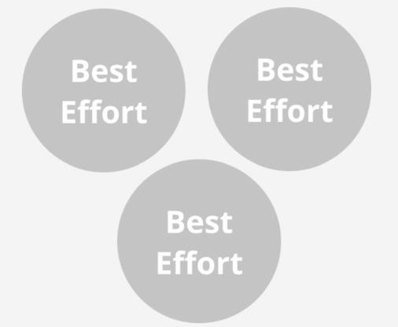
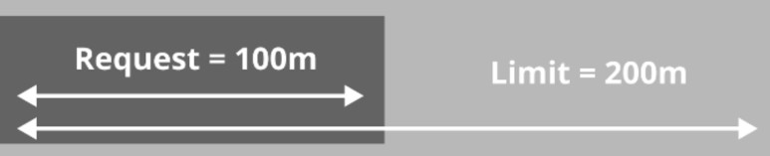

Resource Management
Pods can have resource requests and limits
This allows three quality of service models
Burstable
Guaranteed
https://opensource.com/article/18/12/optimizing- kubernetes-resource-allocation-production
A namespace can have limits and default allocations
Quotas and limits ensure fairness and stability

Slide 19
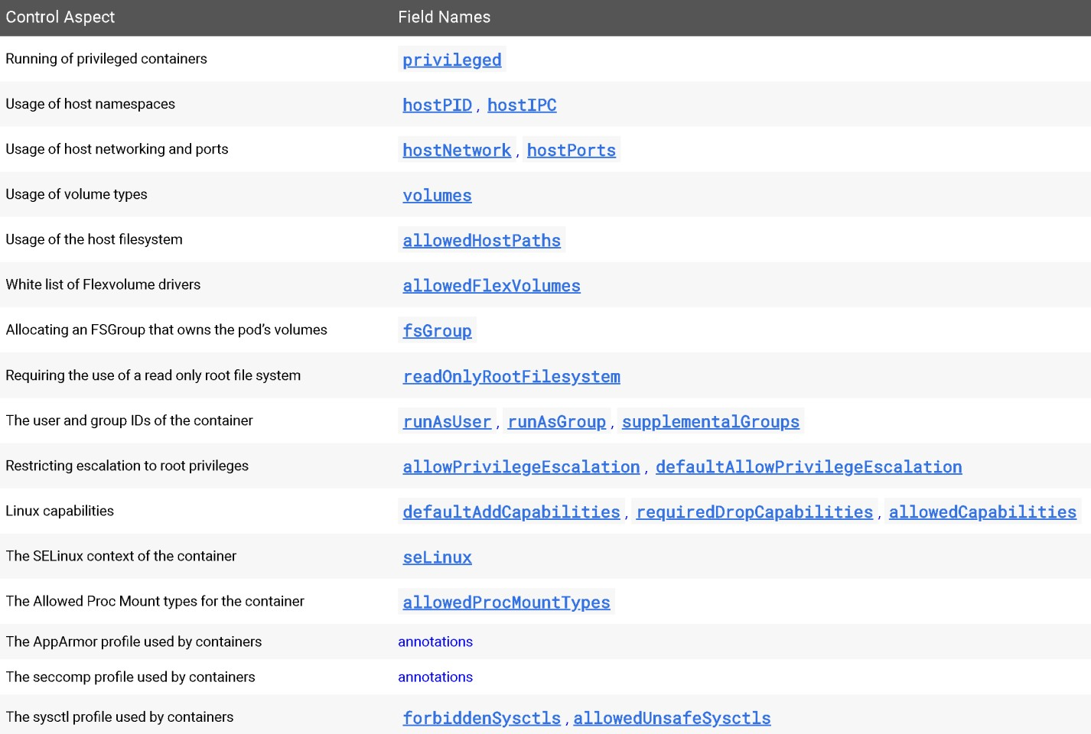
Pod Security Policies
Controls runtime security settings for pods
Enabled at the API Controller
Requires a role binding between pod Service Account and the PSP

Slide 20
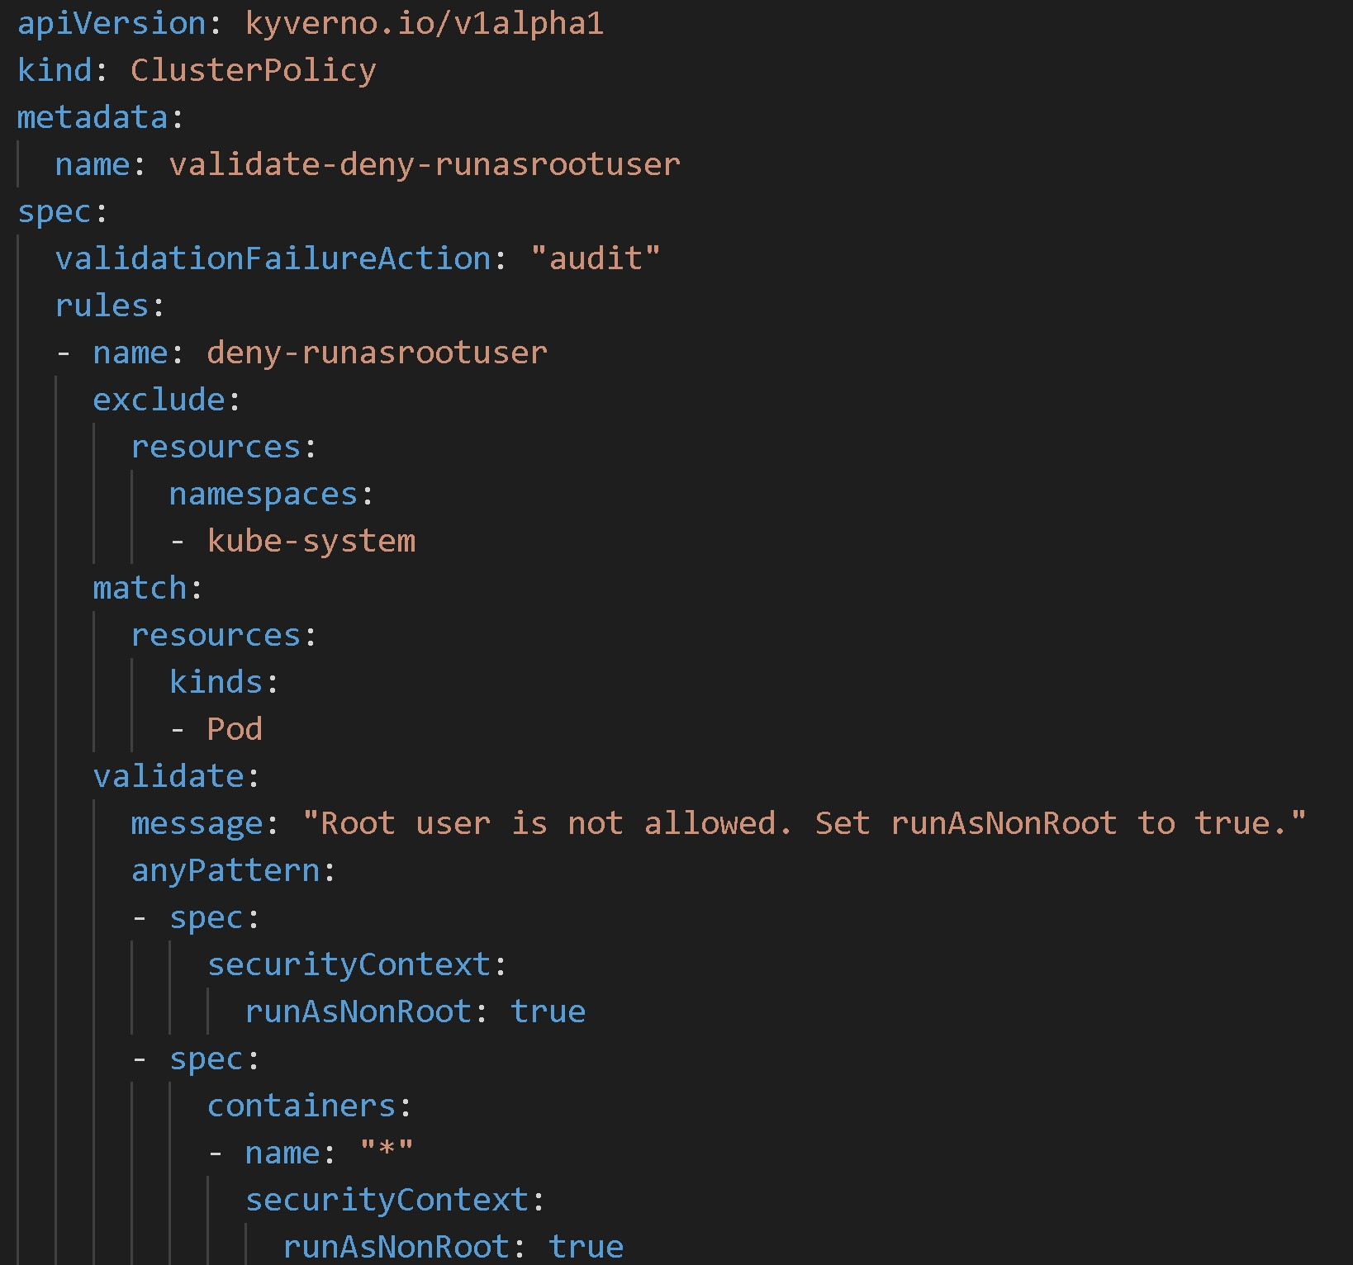
Use a policy engine to audit and enforce
Pod Security Policies are tricky to manage
Require a role binding to SA
Applied in alphabetical order
Kyverno supports enforcement of the important PSP checks
https://github.com/nirmata/kyverno/tree/master/ examples/best_practices

